Slide 1
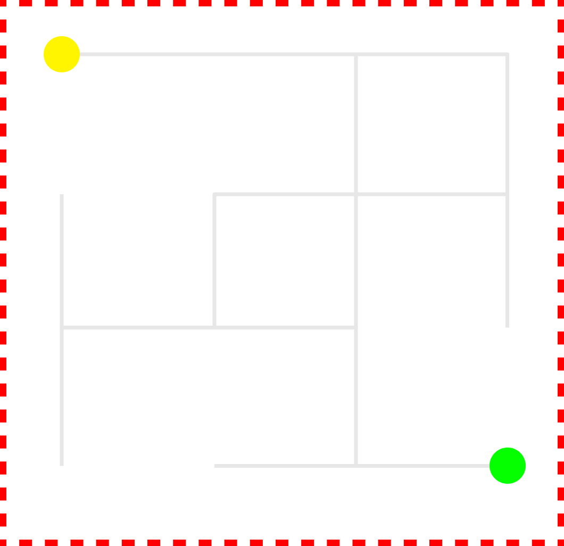
A Basic Line Maze Solver
// Using Left wall algorithm
A Project By :
-> Miraj Maharjan (ACE077BEI021)
-> Elbina Paudel (ACE077BEI014)

Slide 2
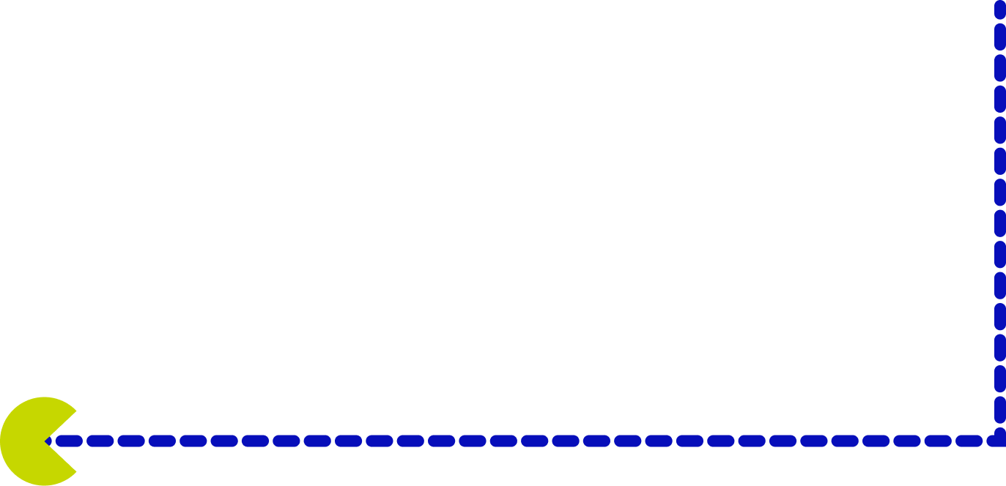
The Problem Statement and Objective:
To solve a simple line maze, of a predefined size (nxn), where each turn is 90 degrees and the distance between consequent nodes are equal. For simplicity, the maze will also have a predefined start and end point.
The objective of this project is to practically demonstrate (visually) the simple working mechanism of the Left-Wall Algorithm

Slide 3
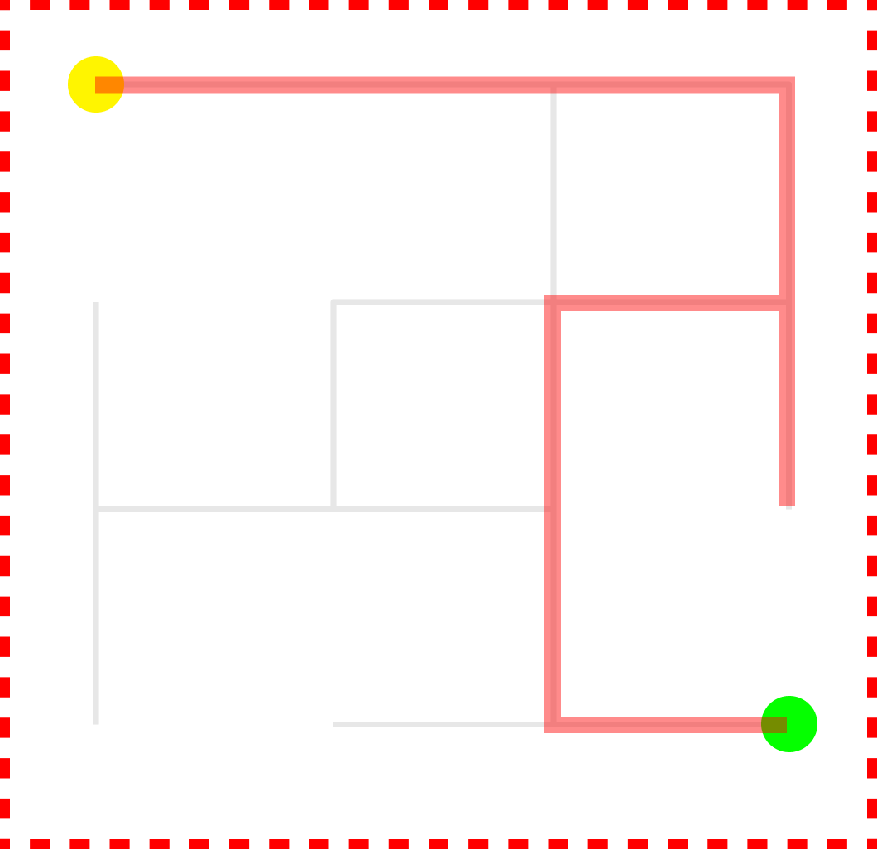
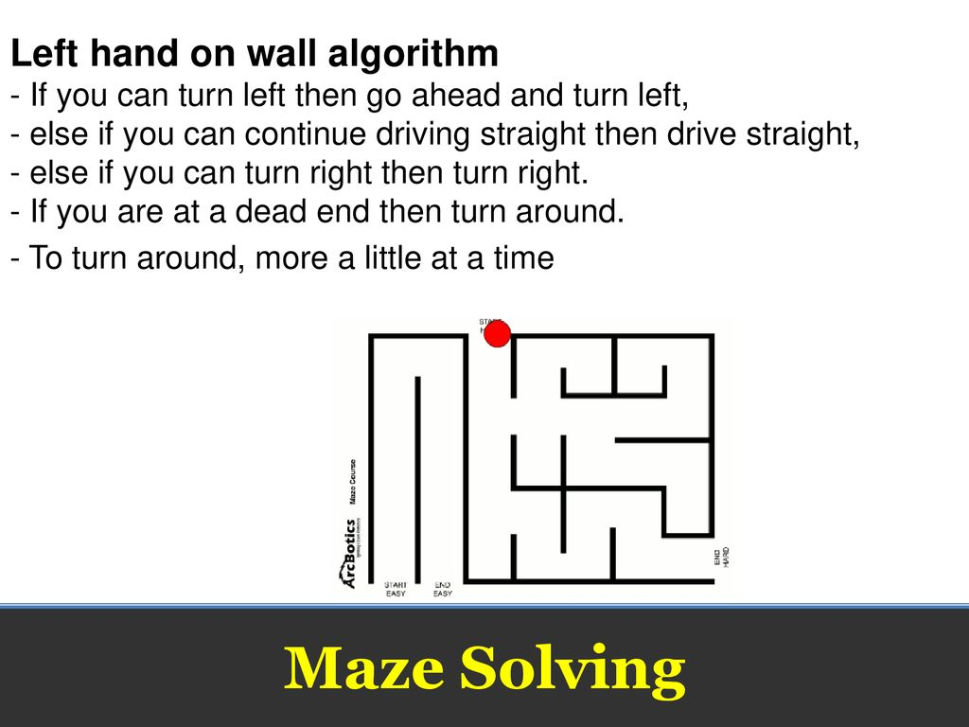

Slide 4
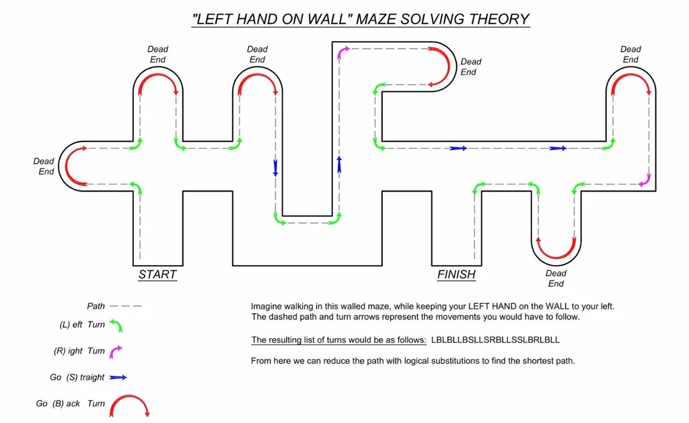

Slide 5
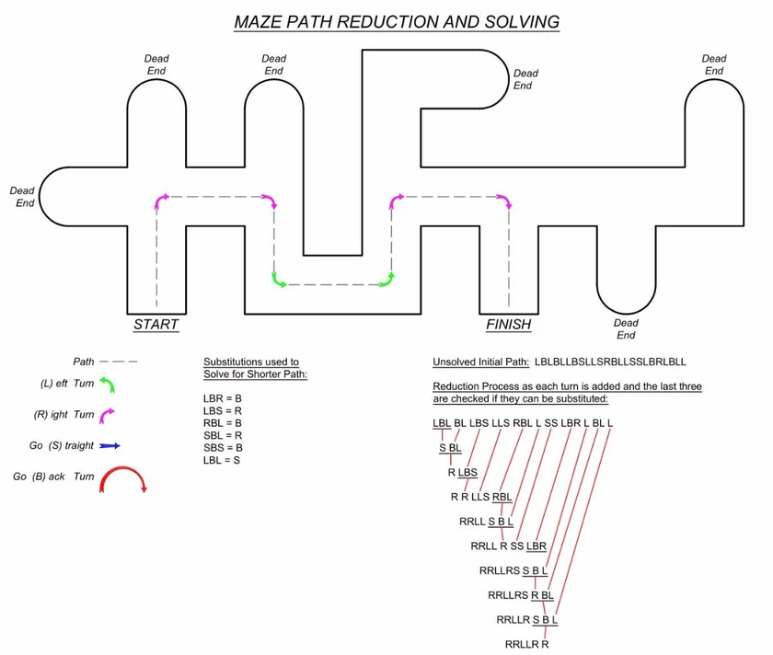

Slide 6
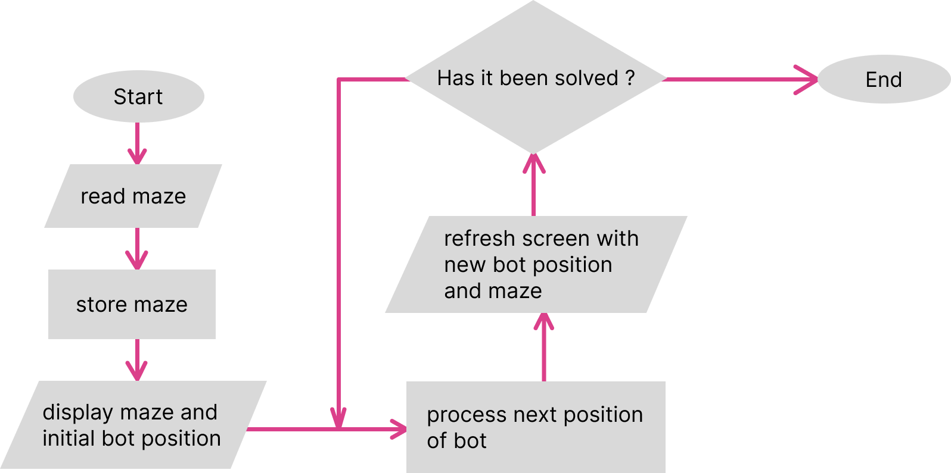
Program Flow :

Slide 7

What can’t it do ?
The short answer is… A lot of things

Slide 8
What can be improved ?
Visualization of Minimum Spanning Tree problems.
BFS and DFS traversal algorithms to find shortest paths of undirected path.
Incorporation of weight to graph edges.
Dijkstra's Algorithm to find shortest path of weighted graph.

Slide 9
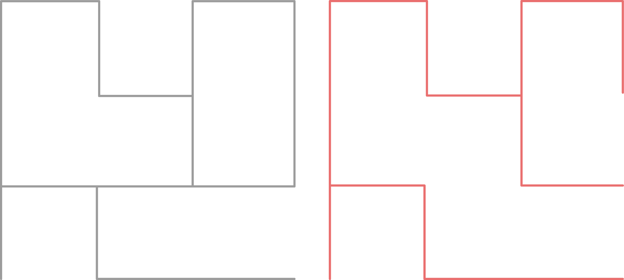


Application Areas :

Slide 10

The floor is now open to Questions
We will try our best to answer any questions relevant to / regarding the project.

